Slide 1






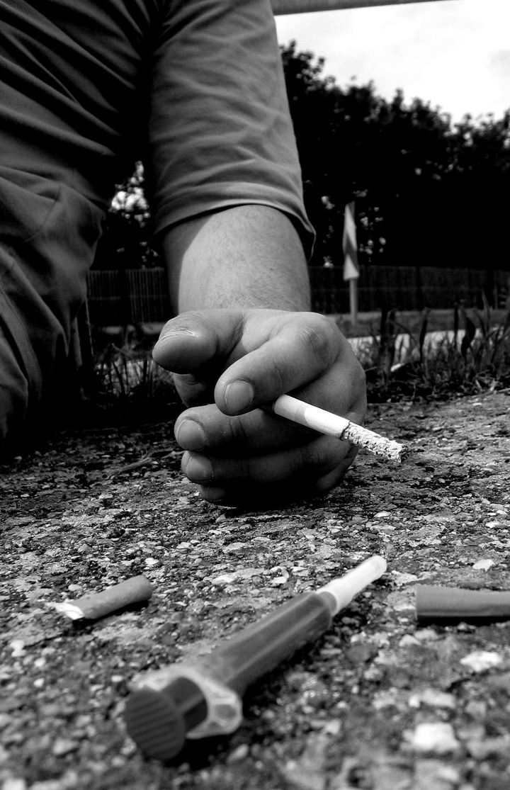




WHAT YOU WILL LEARN
WHAT ARE DRUGS?
TYPES OF DRUGS (USEFUL & HARMFUL).
DRUG ABUSE AND ADDICTION.
EFFECTS OF DRUGS ON THE BODY AND BRAIN.
ALCOHOLISM AND DANGERS OF ALCOHOL.
SMOKING AND LUNG CANCER.
QAT CHEWING PROBLEMS.
GLUE SNIFFING AND ITS RISKS.

Slide 2






WHAT IS A DRUG?
Definition: A drug is any substance that changes how the body works.
Two sides of drugs:
✅ Useful (medicine, treatment).
❌ Harmful (abuse, addiction).
Correct use: Helps cure diseases.
Wrong use: Damages health, can cause death.

Slide 3


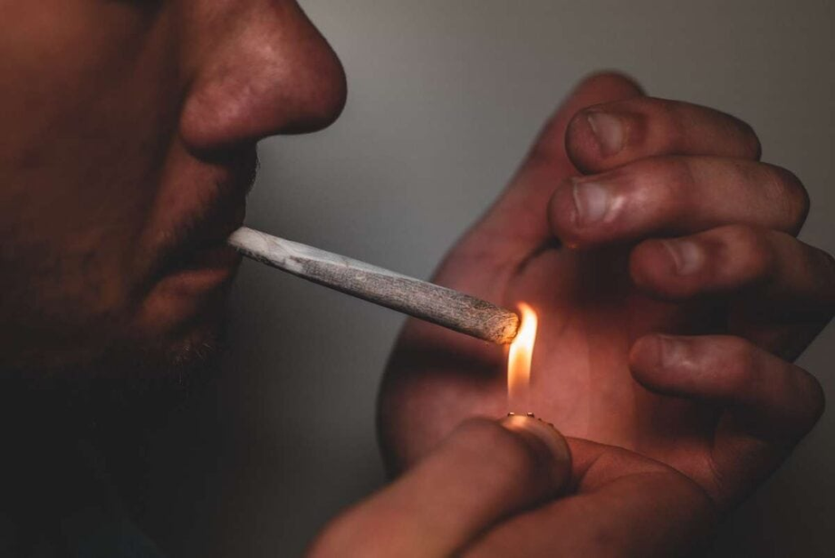


DRUG ABUSE
Drug abuse = Using drugs for fun or without doctor’s advice.
People abuse drugs because they enjoy the effects.
Examples: tobacco, marijuana, cocaine, heroin, alcohol, khat, glue.
Long-term abuse → Addiction (very hard to stop).

Slide 4



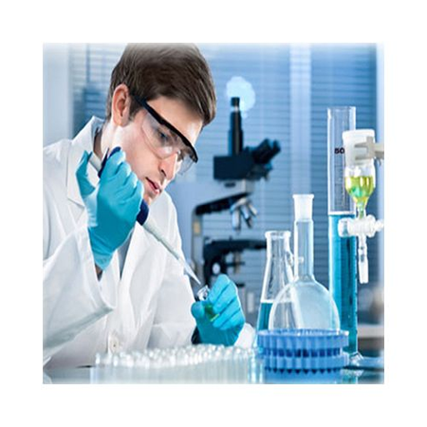


TYPES OF DRUGS
1. Laboratory drugs
2. Herbal/Traditional drugs
Made by chemists.
Examples: Antibiotics (e.g., penicillin, aureomycin) – kill harmful microorganisms.
Sulphonamides – cure bacterial
infections. Aspirin – relieves
headaches. Chloroquine –
prevents malaria.
Save lives and fight diseases.
From plants (flowers, roots, bark).
Passed down for centuries.
Parents of modern medicines.

Slide 5

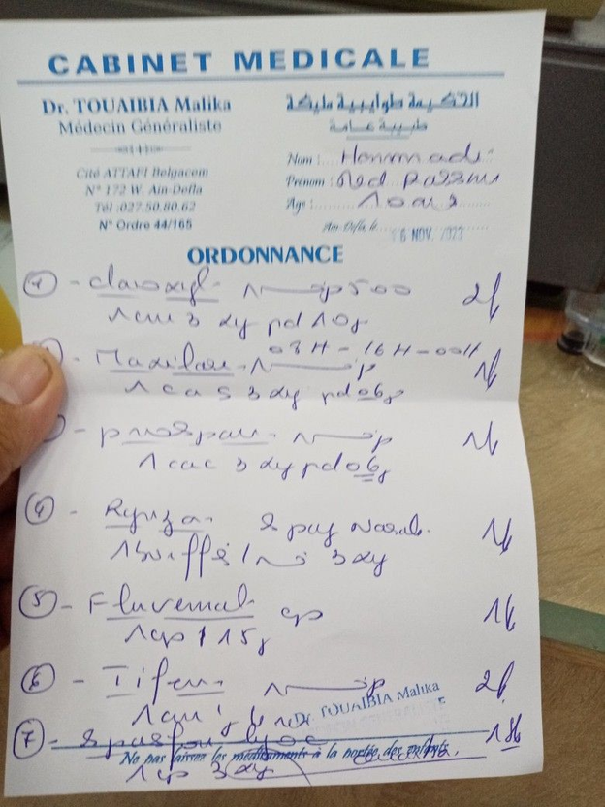



PRESCRIPTION DRUGS
Prescription = Doctor’s written instructions.
Shows correct dose & time.
Most health-improving drugs need prescription.
Wrong use can be harmful.

Slide 6





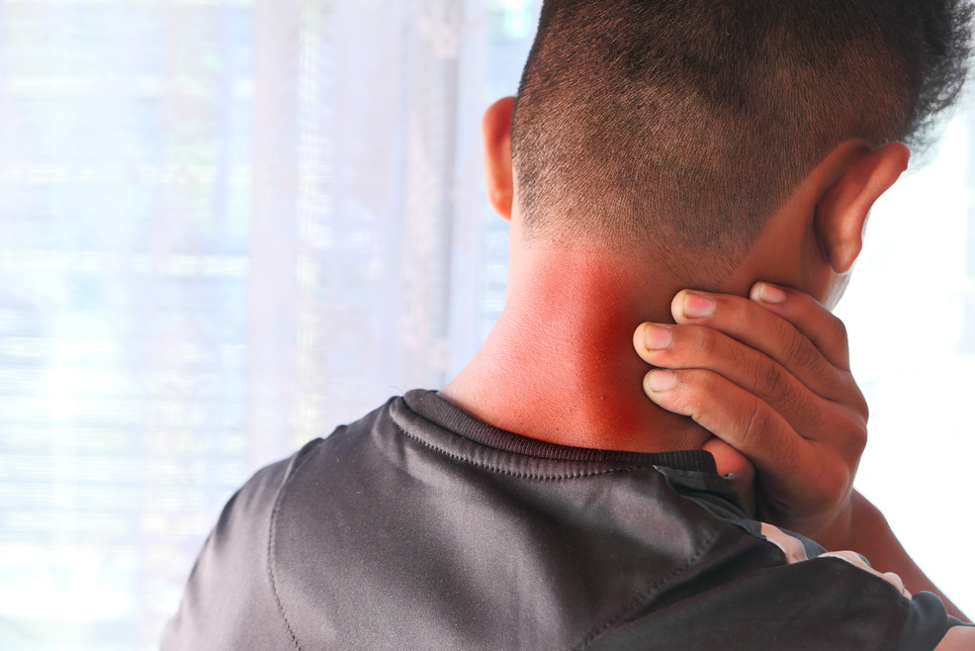
DRUGS THAT AFFECT THE BRAIN
Sedatives → Slow brain, help sleep.
Stimulants → Speed up brain, for depression.
Hallucinogens → Cause false visions.
Pain killers → Block pain signals.
MISUSE = ABUSE → DANGEROUS.

Slide 7
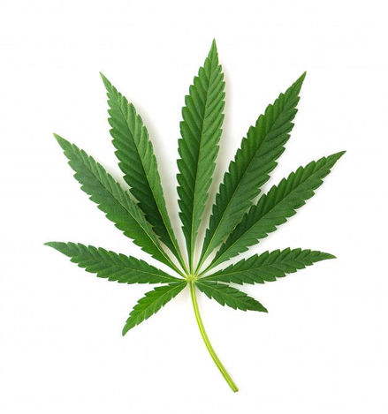
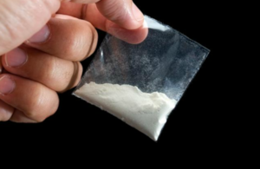
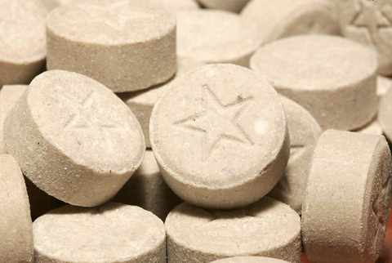
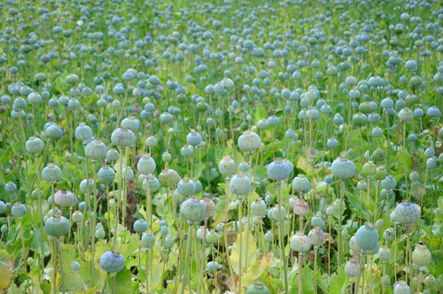
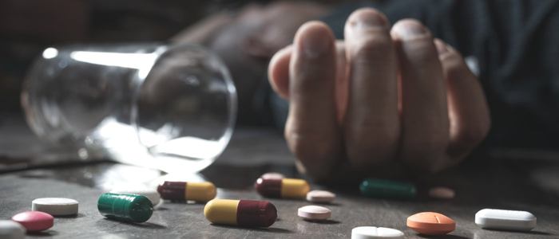
EXAMPLES OF BRAIN DRUGS
Cannabis (bhang, marijuana): Smoked with tobacco, causes laziness, long use → psychosis.
Cocaine: From cocoa plant, reduces appetite, long use → insanity.
Mandrax: Addictive tablet, damages brain → misery.
Morphine & Heroin: Strong painkillers from opium, very addictive.
Overdose: Too much medicine/tablets → abnormal behavior, even death.
→

Slide 8
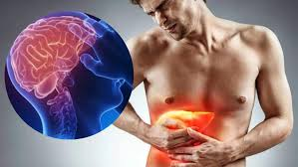
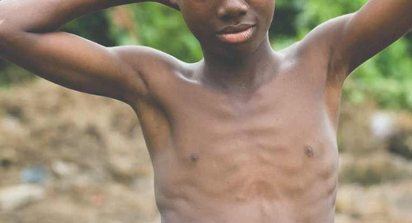

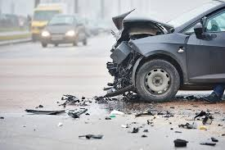
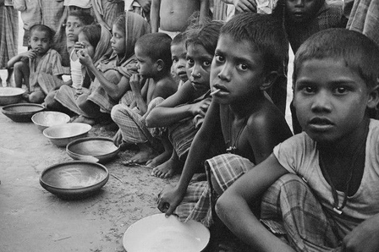

EFFECTS:
ALCOHOLISM
Damages brain, liver
Causes malnutrition, cancer.
Family fights, unhappiness.
DEFINITION: DRINKING TOO MUCH ALCOHOL.
Forbidden in Islam.
Road accidents.
Leads to poverty and neglect.

Slide 9



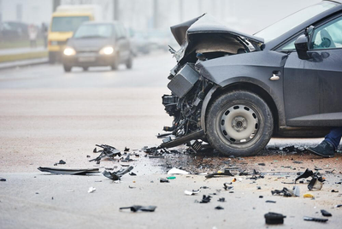
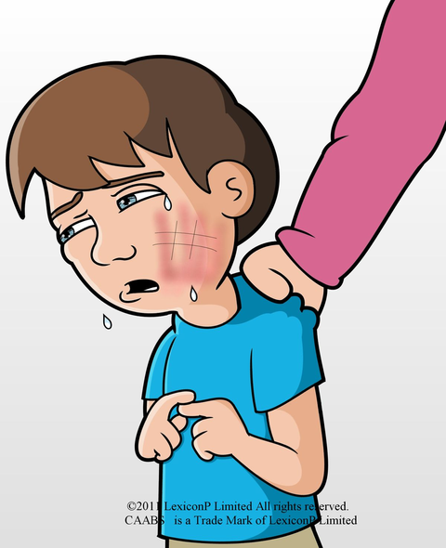
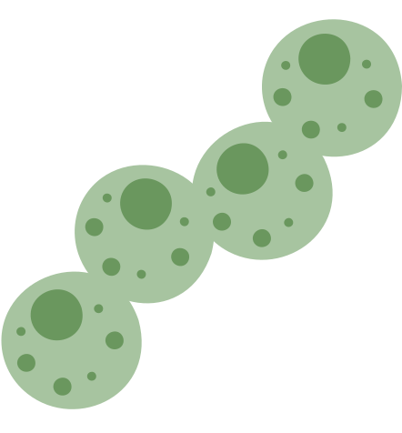
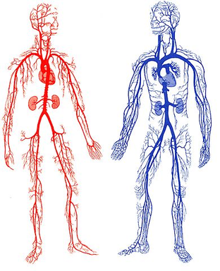
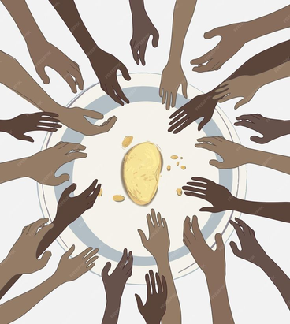
DANGERS OF ALCOHOL
Poor school performance.
Road accidents.
Parents harm or neglect children.
Destroys liver and nervous system.
Causes social and economic problems.

Slide 10

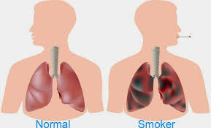
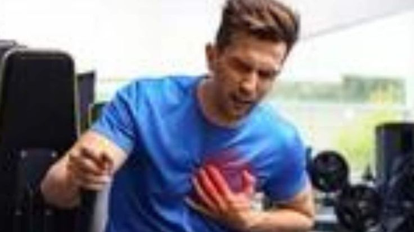
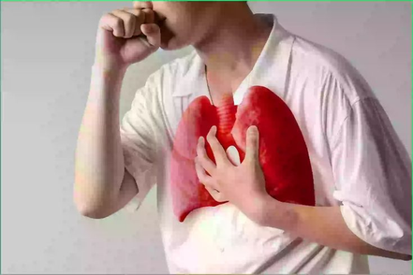
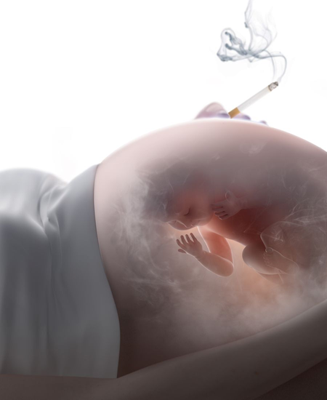
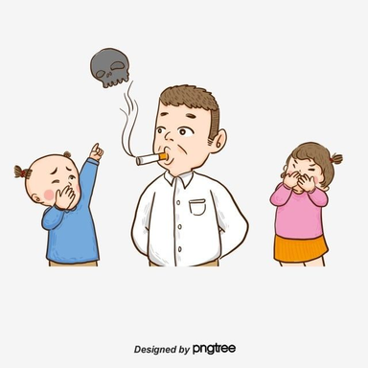

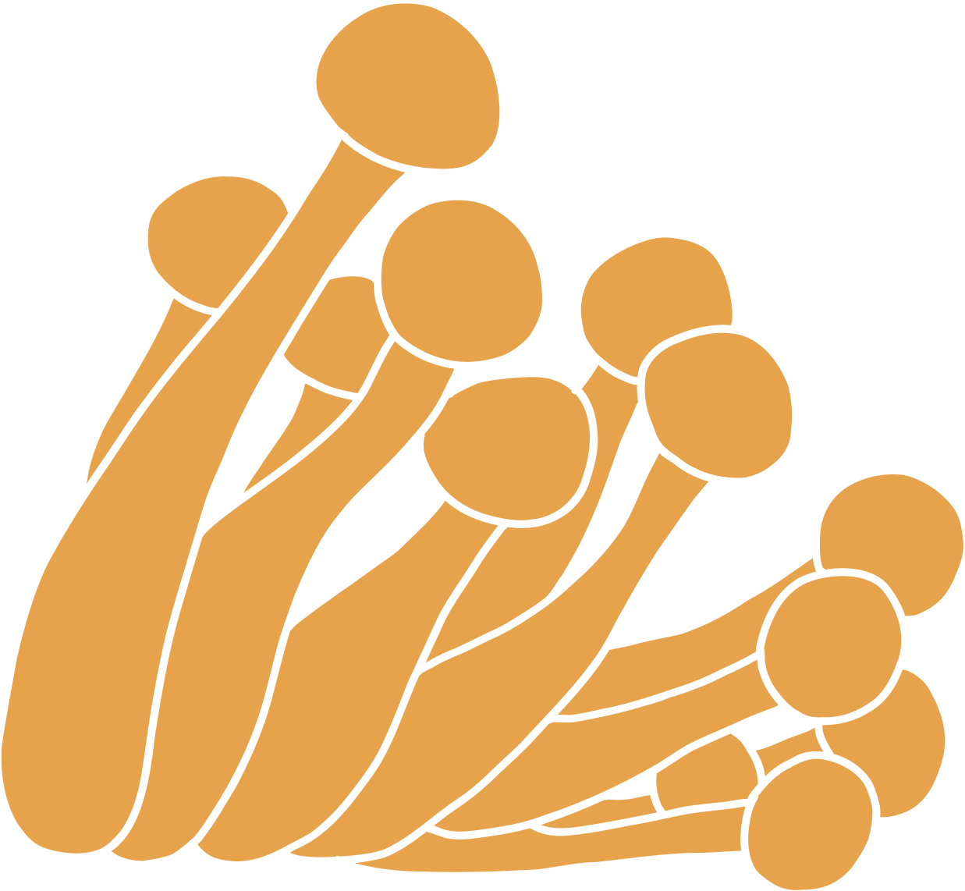


SMOKING
Cigarettes contain tar & nicotine (poisons).
Tar → Blocks lungs, hard to breathe.
Nicotine → Damages heart, risk of heart attack.
Causes lung cancer, poor athletic performance.
Pregnant women who smoke → weak babies.
Second-hand smoke → damages family members.
Expensive and wasteful.

Slide 11


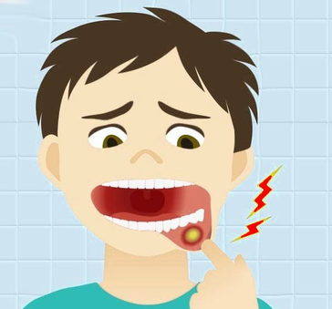
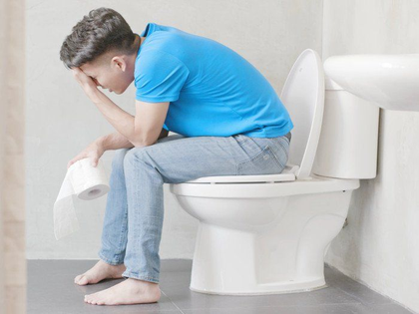
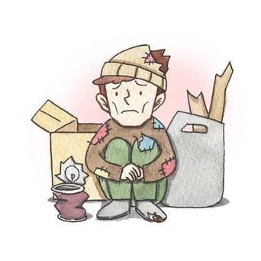
QAT (KHAT)
EFFECTS:
Definition: Plant chewed by many people.
Contains stimulants that affect brain and nerves.
Poor sleep.
Loss of appetite
→ malnutrition.
Mouth & stomach ulcers.
Constipation.
Social and economic problems.

Slide 12

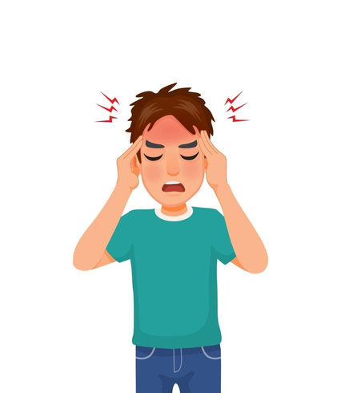

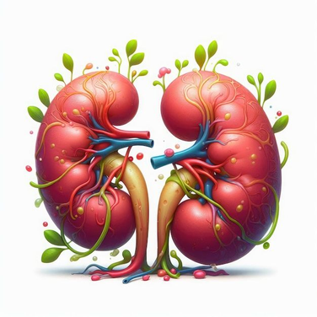

GLUE SNIFFING
CAUSES
People inhale gas, petrol, paint, sprays.
Feeling “floating”.
Headaches, vomiting, unconsciousness.
Fear, panic, madness, fighting.
Damages kidneys, liver, nose, mouth.
Can die from choking or heart/lung failure.

Slide 13

Drugs can save lives if used correctly.
Abuse → addiction, disease, family and social problems.
Alcohol, smoking, qat, and glue sniffing are dangerous habits.
Protect your health and say NO to drug abuse.
CONCLUSION

Slide 14
THANKS YOU!

